Slide 1
COS 212 Binary Trees: Self-Adjusting Trees

Slide 2
Self-Adjusting Trees
Previous techniques focused on constructing a balanced tree with branches of [more or less] equal length
Is tree structure the only driving force behind high efficiency?
What if the nodes you wanted to access the most were closer to the root, and the nodes less frequently accessed were the leaf nodes?
Main idea behind self-adjusting BSTs: retain BST structure, but instead of balancing the tree, propagate the most used nodes to the top of the tree
No restructuring is performed when an element is added or removed
Restructure only happens when a node is accessed
Hopefully, an efficient structure will “emerge” from the tree usage

Slide 3
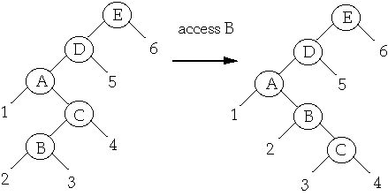
Self-Adjusting Trees
Strategies proposed by Allen, Munro and Bitner:
Single rotation
Does not produce a balanced tree!
Rotate the non-root child around its parent if the child is accessed
Single rotation: access B

Slide 4
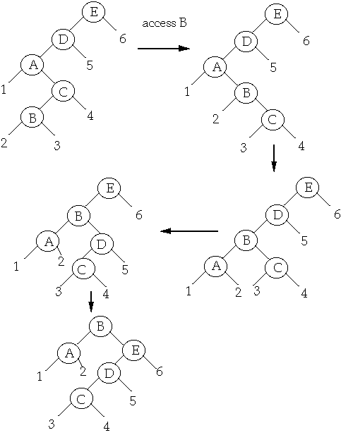
Self-Adjusting Trees
Move-to-root
Does not produce a balanced tree!
Repeat child-parent rotation until the element being accessed becomes the root
Problem with 1 and 2:
Both single rotation and move-to-root may lead to inefficient, elongated trees

Slide 5
Splay Trees
Modification of move-to-root strategy
Does not produce a balanced tree!
Goal is still to move accessed element to the top
Idea:
Apply rotations until the accessed node is the root of the tree
Rotations occur in pairs involving the accessed node, the accessed node’s parent, and the accessed node’s grandparent
Complexity of splay trees:
Access one node: O(lg n)
Same as worst case in balanced tree
Sequence of m node accesses: O(m lg n)
Comparable to a balanced tree

Slide 6
Splay Trees
Let A = accessed node, P = its parent, G = its grandparent
Rotations are applied to move A up, according to three cases:
Case 1: P is the root
Case 2: Homogeneous configuration
Case 3: Heterogeneous configuration
Stop when A is the root

Slide 7
Splay Trees
Let A = accessed node, P = its parent, G = its grandparent
Rotations are applied to move A up, according to three cases:
Case 1: P is the root
Singular splay: Rotate A about P
Case 2: Homogeneous configuration
A and P are both left children (or both right children)
Homogeneous splay: Rotate P about G, then A about P
Y
X
access X
X
c
a
Y
a
b
b
c
Z
X
Y
Y
d
a
Y
access X
X
Z
b
X
c
Z
a
b
c
d
a
b
c
d

Slide 8
Splay Trees
Let A = accessed node, P = its parent, G = its grandparent
Rotations are applied to move A up, according to three cases:
Case 3: Heterogeneous configuration
A is right child of P, and P is left child of G, OR
A is left child of P, and P is right child of G
Heterogeneous splay: Rotate A about P and then about G
Z
Z
X
W
d
X
d
access X
W
Z
a
X
W
c
a
b
c
d
b
c
a
b

Slide 9
Splay Trees VS Move-to-root
Case 1: P is the root
Singular splay: Rotate A about P
X
Splay
Access X
Y
a
Y
X
c
b
c
a
b
X
Move to root
a
Y
b
c

Slide 10
Splay Trees VS Move-to-root
Case 2: Homogeneous configuration
A and P are both left children (or both right children)
Homogeneous splay: Rotate P about G, then A about P
X
Y
a
Y
Splay
X
Z
b
Z
Z
Access X
a
b
c
d
c
d
Y
d
X
c
Z
X
a
b
X
d
a
Z
Move-to-root
a
Y
Y
d
b
c
b
c

Slide 11
Splay Trees VS Move-to-root
Case 3: Heterogeneous configuration
A is right child of P, and P is left child of G, OR
A is left child of P, and P is right child of G
Heterogeneous splay: Rotate A about P and then about G
Z
X
Splay
X
d
W
Z
W
c
Access X
Z
a
b
c
d
a
b
W
d
a
X
b
c
Z
X
Move-to-root
X
d
W
Z
W
c
a
b
c
d
a
b

Slide 12
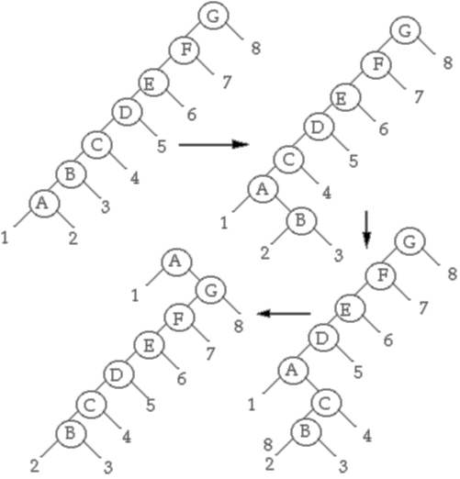
Splay Trees VS Move-to-root
Move-to-root:
Access A
A is at the top, but the structure of the tree has not changed much

Slide 13
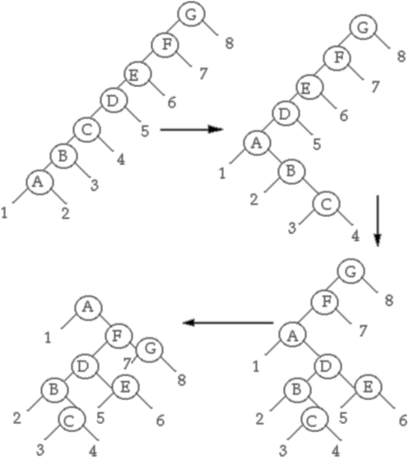
Splay Trees VS Move-to-root
Splaying:
Access A
Note: a much more balanced tree is obtained!
Double rotations that are top-down as well as bottom-up help to flatten the tree and improve its structure

Slide 14
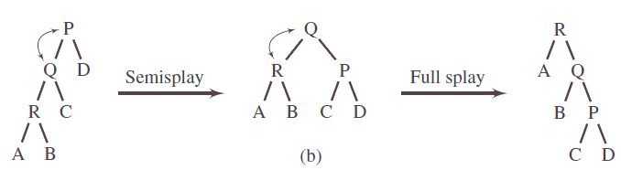
Semi-Splaying
Splaying is efficient only if you do in fact access some nodes more often than others
Not always the case!
Can we combine balancing and splaying to promote an efficient (i.e. more balanced) structure?
Semi-splaying does this by modifying the homogenous case
Idea: For the homogenous configuration, perform only the first step of a full splay and continue until the root is reached
Accessed node moves near the root rather than to the root
Advantage: The resulting tree is more balanced, and remains relatively balanced
Access R
(Homogeneous
configuration)

Slide 15
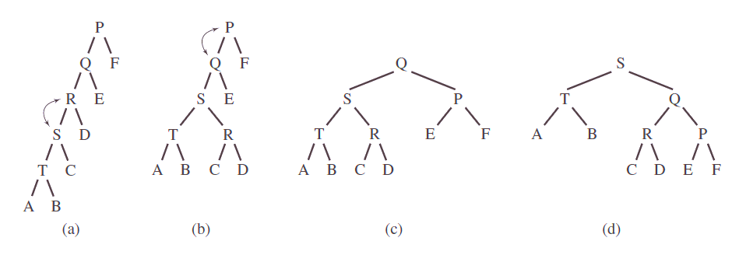
Semi-Splaying
Homogeneous configuration makes only one rotation:
Rotate parent about the grandparent, forget about the child!
Access T in a semi-splay mode:
Access T, which is homogeneous, so splay its parent: S
Semi-splaying: Semi-splay S-Q-P, which is homogeneous, so splay the parent of S: Q
The tree is balanced after T has been accessed!
Second access to T: The tree remains balanced
Access T
(Homogeneous
configuration)
Access T again
(Homogeneous
configuration)

